Slide 1
Advanced C
Strings and Vectors in C++
Th.S Nguyen Minh Anh
Phenikaa University
Last Update: 7th February 2023

Slide 2
Outline
String
Operations on strings
Dealing with the Characters in a string
Vector
Defining and Initializing vectors vector Operations
Exercises

Slide 3
Library string Type
A string is a variable-length sequence of characters.
To use the string type, we must include the string header.
#include <string>
using std::string;

Slide 4
Defining and Initializing strings
The most common ways to initialize strings:
string s1; // default initialization; s1 is the empty string
string s2(s1); // s2 is a copy of s1
string s2 = s1; // equivalent to s2(s1), s2 is a copy of s1 string s3 = "saka"; // s3 is a copy of the string literal string s3("saka"); // equivalent to s3 = "saka"
string s4(10, ’c’); // s4 is cccccccccc

Slide 5
Outline
String
Operations on strings
Dealing with the Characters in a string
Vector
Defining and Initializing vectors vector Operations
Exercises

Slide 6
The most common string operations
os << s is >> s
getline(is, s) s.empty()
s.size() s[n]
s1 + s2 s1 = s2 s1 == s2 s1 != s2
<, <=, >, >=
Writes s onto output stream os. Returns os.
Reads whitespace-separated string from is into s. Returns is.
Reads a line of input from is into s. Returns is.
Returns true if s is empty; otherwise returns false.
Returns the number of characters in s.
Returns a reference to the char at position n in s; positions start at 0.
Returns a string that is the concatenation of s1 and s2.
Replaces characters in s1 with a copy of s2.
The strings s1 and s2 are equal if they contain the same characters.
Equality is case-sensitive.
Comparisons are case-sensitive and use dictionary ordering.

Slide 7
Reading and Writing strings
The string input operator reads and discards any leading whitespace (e.g., spaces, newlines, tabs). It then reads characters until the next whitespace character is encountered.
int main()
{
string s; // empty string
cin >> s; // read a whitespace-separated string into s cout << s << endl; // write s to the output
return 0;
}
Question: If the input to this program is " Hello World! ", the output?

Slide 8
Reading and Writing strings
The string input operator reads and discards any leading whitespace (e.g., spaces, newlines, tabs). It then reads characters until the next whitespace character is encountered.
int main()
{
string s; // empty string
cin >> s; // read a whitespace-separated string into s cout << s << endl; // write s to the output
return 0;
}
Question: If the input to this program is " Hello World! ", the output? "Hello"

Slide 9
Reading and Writing strings
Like the input and output operations on the built-in types, the string oper ators return their left-hand operand as their result. Thus, we can chain together multiple reads or writes:
string s1, s2;
cin >> s1 >> s2; // read first input into s1, second into s2 cout << s1 << s2 << endl; // write both strings
Question: If we give this version of the program the same input " Hello World! ", our output would be?

Slide 10
Reading and Writing strings
Like the input and output operations on the built-in types, the string oper ators return their left-hand operand as their result. Thus, we can chain together multiple reads or writes:
string s1, s2;
cin >> s1 >> s2; // read first input into s1, second into s2 cout << s1 << s2 << endl; // write both strings
Question: If we give this version of the program the same input " Hello World! ", our output would be? "HelloWorld!"

Slide 11
Reading and Writing strings
Reading an Unknown Number of strings
int main()
{
string word;
while (cin >> word) // read until end-of-file
cout << word << endl; // write each word followed by a new line return 0;
}

Slide 12
Using getline to Read an Entire Line
If we do not want to ignore the whitespace in our input, we can use the getline
function instead of the >> operator. The getline function:
takes an input stream and a string
reads the given stream up to and including the first newline and stores what it read—not including the newline—in its string argument
After getline sees a newline, even if it is the first character in the input, it stops reading and returns.
If the first character in the input is a newline, then the resulting string is the empty string.

Slide 13
Using getline to Read an Entire Line
Like the input operator, getline returns its istream argument. As a result, we can use getline as a condition.
For example, we can rewrite the previous program that wrote one word per line to write a line at a time instead:
int main()
{
string line;
// read input a line at a time until end-of-file while (getline(cin, line))
cout << line << endl;
return 0;
}

Slide 14
The string empty and size Operations
The empty function returns a bool indicating whether the string is empty.
// read input a line at a time and discard blank lines
while (getline(cin, line)) if (!line.empty())
cout << line << endl;
The size member returns the length of a string (i.e., the number of charac- ters in it).
string line;
// read input a line at a time and print lines that are longer than 80 characters
while (getline(cin, line))
if (line.size() > 80) cout << line << endl;

Slide 15
Comparing strings
The equality operators (== and !=) test whether two strings are equal or unequal, respectively.
The relational operators <, <=, >, >= test whether one string is less than, less than or equal to, greater than, or greater than or equal to another in a lexicographical manner.
string str = "Hello";
string phrase = "Hello World"; string slang = "Hiya";
Question: str vs phrase vs slang?

Slide 16
Assignment for strings
We can assign one string object to another:
string st1(10, ’c’), st2; // st1 is cccccccccc; st2 is an empty string
st2 = "Bukayo Saka"; // st2 now is assigned to literal "Bukayo Saka" st1 = st2; // assignment: replace contents of st1 with a copy of st2
// both st1 and st2 are now the empty string

Slide 17
Adding Two strings
string s1 = "hello, ", s2 = "world\n";
string s3 = s1 + s2; // s3 is hello, world\n s1 += s2; // equivalent to s1 = s1 + s2

Slide 18
Adding Literals and strings
The string library lets us convert both character literals and character string literals to strings.
string s1 = "hello", s2 = "world";
string s3 = s1 + ", " + s2 + ’\n’;
string s4 = s1 + ", ";
string s5 = "hello" + ", "; string s6 = s1 + ", " + "world"; string s7 = "hello" + ", " + s2;

Slide 19
Adding Literals and strings
The string library lets us convert both character literals and character string literals to strings.
string s1 = "hello", s2 = "world";
string s3 = s1 + ", " + s2 + ’\n’;
string s4 = s1 + ", "; // ok: adding a string and a literal
string s5 = "hello" + ", "; // error: no string operand
string s6 = s1 + ", " + "world"; // ok: each + has a string operand string s7 = "hello" + ", " + s2; // error: cant add string literals
Warning: For historical reasons, and for compatibility with C, string literals are not standard library strings. It is important to remember that these types differ when you use string literals and library strings.

Slide 20
Outline
String
Operations on strings
Dealing with the Characters in a string
Vector
Defining and Initializing vectors vector Operations
Exercises

Slide 21
Processing Every Character? Use Range-Based for
To iterates through the elements in a given sequence and performs some operation on each value in that sequence
for (declaration : expression)
statement
expression is an object of a type that represents a sequence
declaration defines the variable that we’ll use to access the underlying elements in the sequence
As a string represents a sequence of characters
string str("some string");
// print the characters in str one character to a line for (auto c : str) // for every char in str
cout << c << endl; // print the current char followed by a newline

Slide 22
Using a Range for to Change the Characters in a string
If we want to change the value of the characters in a string, we must define the loop variable as a reference type
string s("Hello World!!!"); // convert s to uppercase
for (auto &c : s) // for every char in s
c = toupper(c); // c is a reference, so the assignment changes the char in s
cout << s << endl;

Slide 23
Processing Only Some Characters?
The following example uses the subscript operator to print the first character in a string:
if (!s.empty()) // make sure there’s a character to print
cout << s[0] << endl; // print the first character in s
or to print the first n characters:
if (!s.empty()) // make sure there’s a character to print
for (int i = 0; i < n; ++i) cout << s[i] << endl;

Slide 24
Outline
String
Operations on strings
Dealing with the Characters in a string
Vector
Defining and Initializing vectors vector Operations
Exercises

Slide 25
Outline
String
Operations on strings
Dealing with the Characters in a string
Vector
Defining and Initializing vectors vector Operations
Exercises

Slide 26
Vector
a collection of objects, all of which have the same type.
every object in the collection has an associated index, which gives access to that object.
often referred to as a container because it ”contains” other objects

Slide 27
Vector
To use a vector, we must include the appropriate header.
#include <vector>
using std::vector;
The additional information we supply is the type of the objects the vector will hold:
vector<int> ivec; // ivec holds objects of type int
vector<Sales_item> Sales_vec; // holds Sales_items vector<vector<string>> file; // vector whose elements are vectors

Slide 28
Defining vectors
We can default initialize a vector, which creates an empty vector of the specified type:
vector<string> svec; // default initialization; svec has no
elements
We can also supply initial value(s) by copying elements from another vector.
vector<int> ivec; // initially empty
// give ivec some values
vector<int> ivec2(ivec); //copy elements of ivec into ivec2 vector<int> ivec3 = ivec; //copy elements of ivec into ivec3 vector<string> svec(ivec2); //error: svec holds strings, not ints

Slide 29
List Initializing a vector
We can list initialize a vector from a list of zero or more initial element values enclosed in curly braces:
vector<string> articles = {"a", "an", "the"};
vector<string> v1{"a", "an", "the"}; // list initialization vector<string> v2("a", "an", "the"); // error

Slide 30
Creating a Specified Number of Elements
We can also initialize a vector from a count and an element value
vector<int> ivec(10, -1); // ten int elements, each initialized to -1
vector<string> svec(10, "hi!"); // ten strings; each element is "hi!"

Slide 31
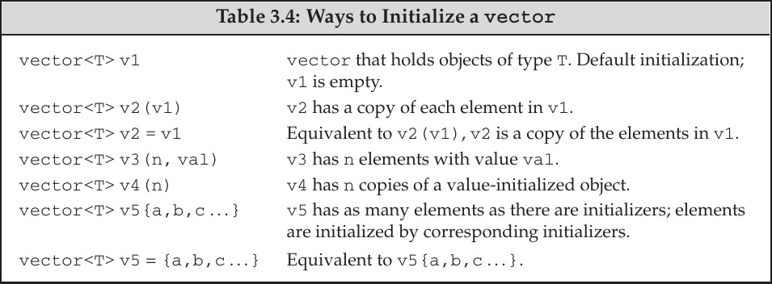
Common ways to Initialize a vector

Slide 32
Outline
String
Operations on strings
Dealing with the Characters in a string
Vector
Defining and Initializing vectors vector Operations
Exercises

Slide 33
Adding Elements to a vector
The push back operation takes a value and ”pushes” that value as a new last element onto the ”back” of the vector.
vector<int> v2; // empty vector
for (int i = 0; i != 100; ++i)
v2.push_back(i); // append sequential integers to v2
// at end of loop v2 has 100 elements, values 0 . . . 99
Using the same approach, we can read and store an unknown number of values in text
// read words from the standard input and store them as elements in a
vector string word;
vector<string> text; // empty vector
while (cin >> word)
text.push_back(word); // append word to text

Slide 34
Questions
Create a vector of n first prime numbers
Create a vector containing numbers satisfy certain conditions

Slide 35
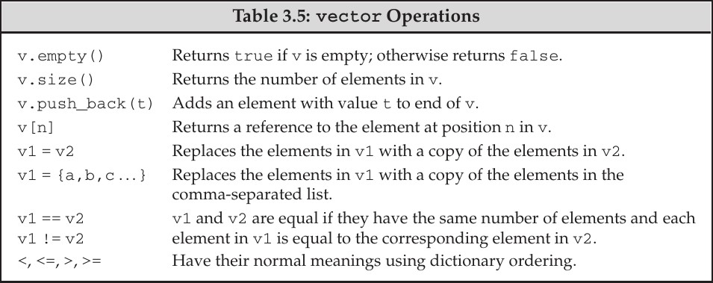
Other vector operations

Slide 36
Outline
String
Operations on strings
Dealing with the Characters in a string
Vector
Defining and Initializing vectors vector Operations
Exercises

Slide 37
Exercises

